Slide 1
DaTABASE ProJECT
EMPLOYEE management system
MEMBERS:
1)Muhammad farzan(bse-23f-080)
2)Zaid khalid(bse-23f-084)
3)mussadiq(bse-23f-089)

Slide 2
Introduction
EMPLOYEE MANAGEMENT SYSTEM: Employee Management System is designed to automate the process of managing employees within an organization. This System include features like keeping track of Employees attendance, performance evaluations, storing information on an Employee Etc.
TABLES: Employee Management System has 10 total tables, Each storing valuable information on an Employee. Tables are as follows:
1)Employee
2)Department
3)Employee Address
4)Employee Contacts

Slide 3
Introduction (Cont…)
5)Employee Projects
6)Employee Reviews
7)Employee Skills
8)Employee Attendance
9)Employee Benefits
10)Employee Training

Slide 4
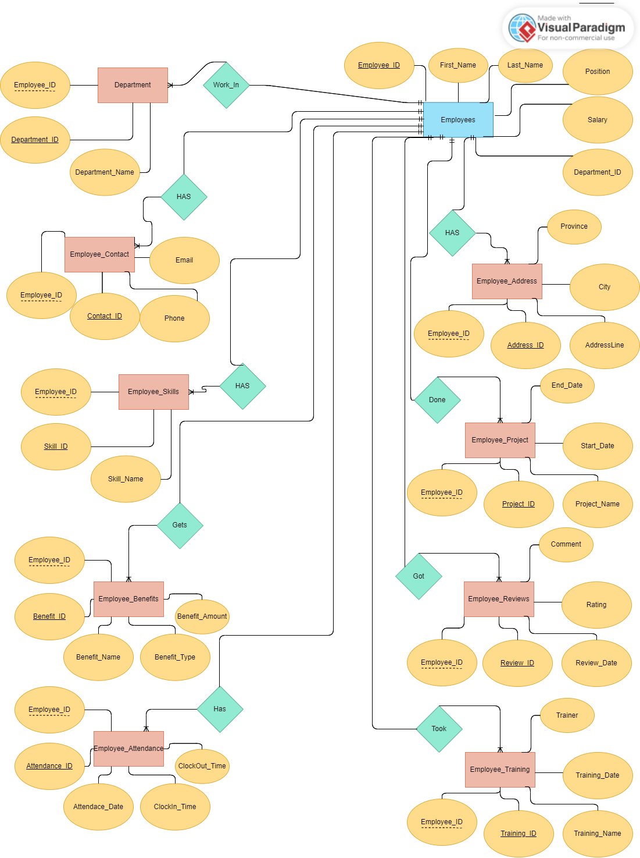
ENTITY RELATIONSHIP MODEL

Slide 5
CoNtribution of each partner
1)MUHAMMAD FARZAN:
Created Tables.
Created ER Model
2)ZAID AND MUSSADIQ:
Used Queries.

Slide 6
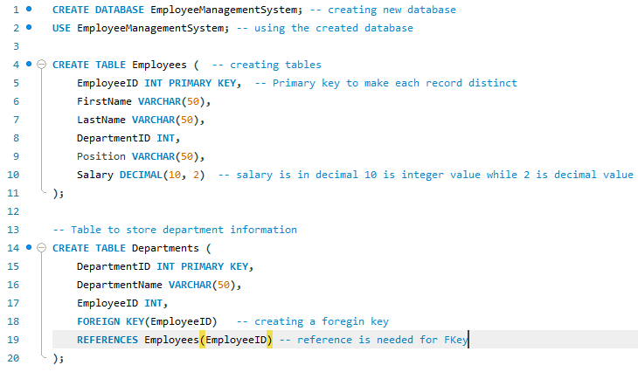
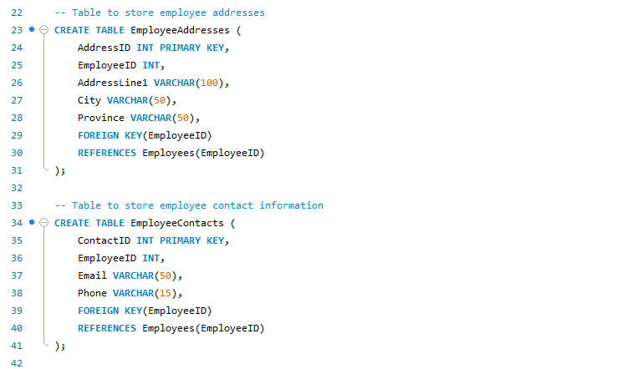
Queries

Slide 7
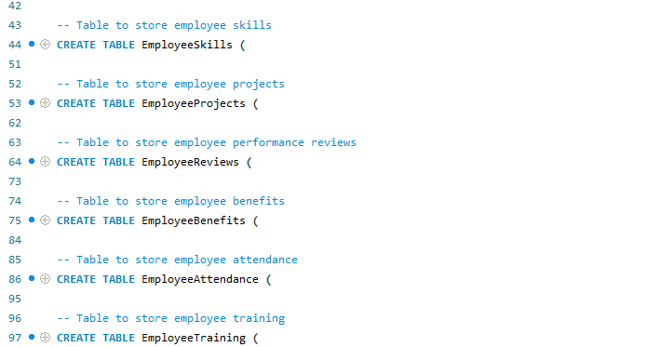
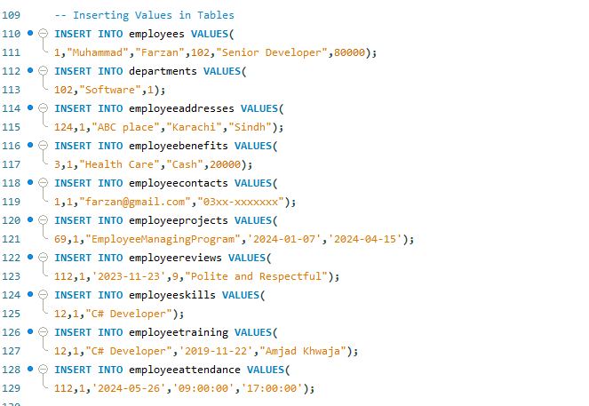
QUERIES (CONT…)

Slide 8
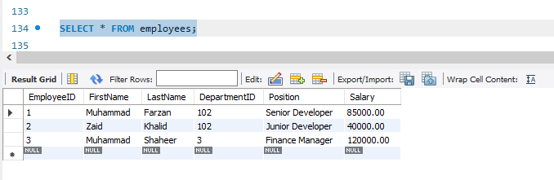
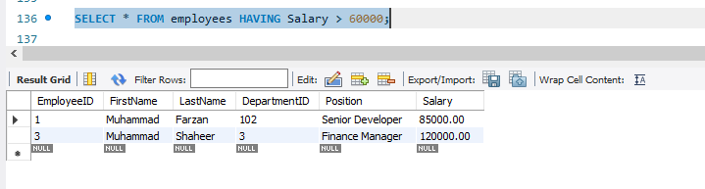
Queries (Cont…)

Slide 9
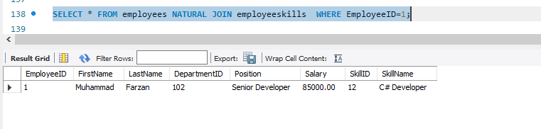
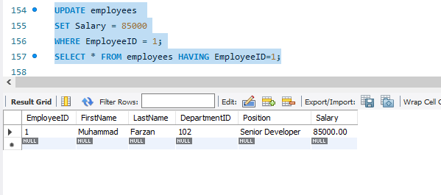
Queries (Cont…)

Slide 10
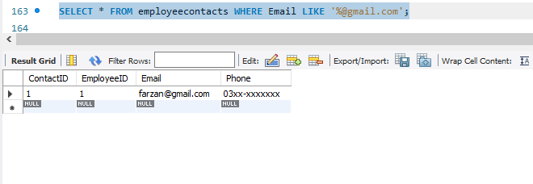
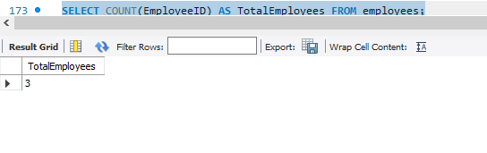
Queries (Cont…)

Slide 11
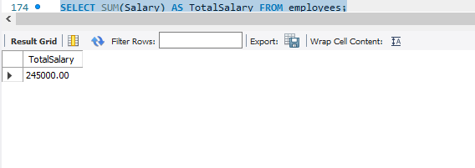
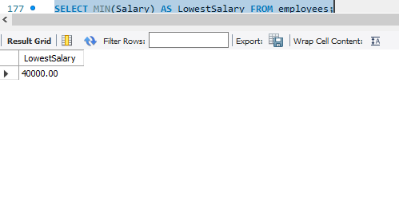
Queries (Cont…)

Slide 12
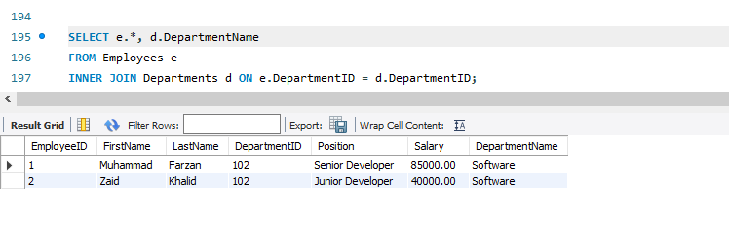
Queries (Cont…)

Slide 13
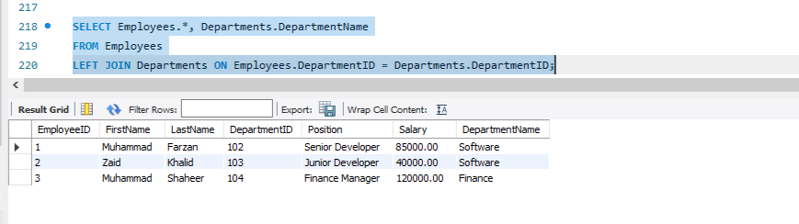
Queries (Cont…)

Slide 14
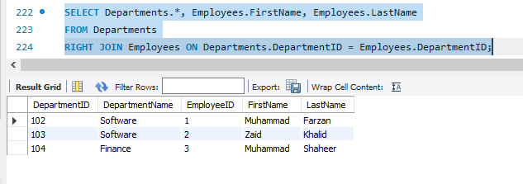
Queries (Cont…)

Slide 15
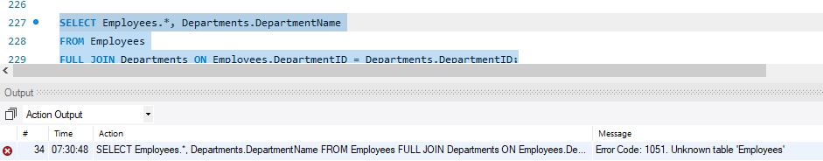
Queries (Cont…)

Slide 16
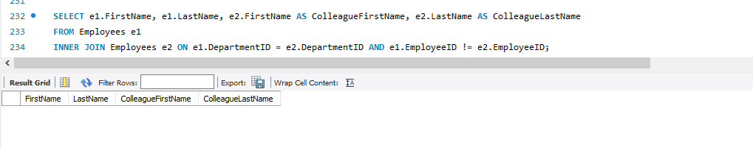
Queries (Cont…)

Slide 17
THE END
THANK YOU

